Slide 1


FITNESS
APP
BASAVARAJ PATIL
SAURAV SINGH
BHUVAN RAJ
ROHIT
RAHUL
BOYUAN YE
MALAV BHAT
REVANTH

Slide 2

OUR PROJECT
Our fitness app, meticulously crafted with Java, seamlessly blends innovation and functionality to redefine your fitness journey. Leveraging the power of Java's robust programming capabilities, our app delivers a user-centric experience, providing personalized workout routines and insightful analytics

Slide 3





TECH STACK

Slide 4

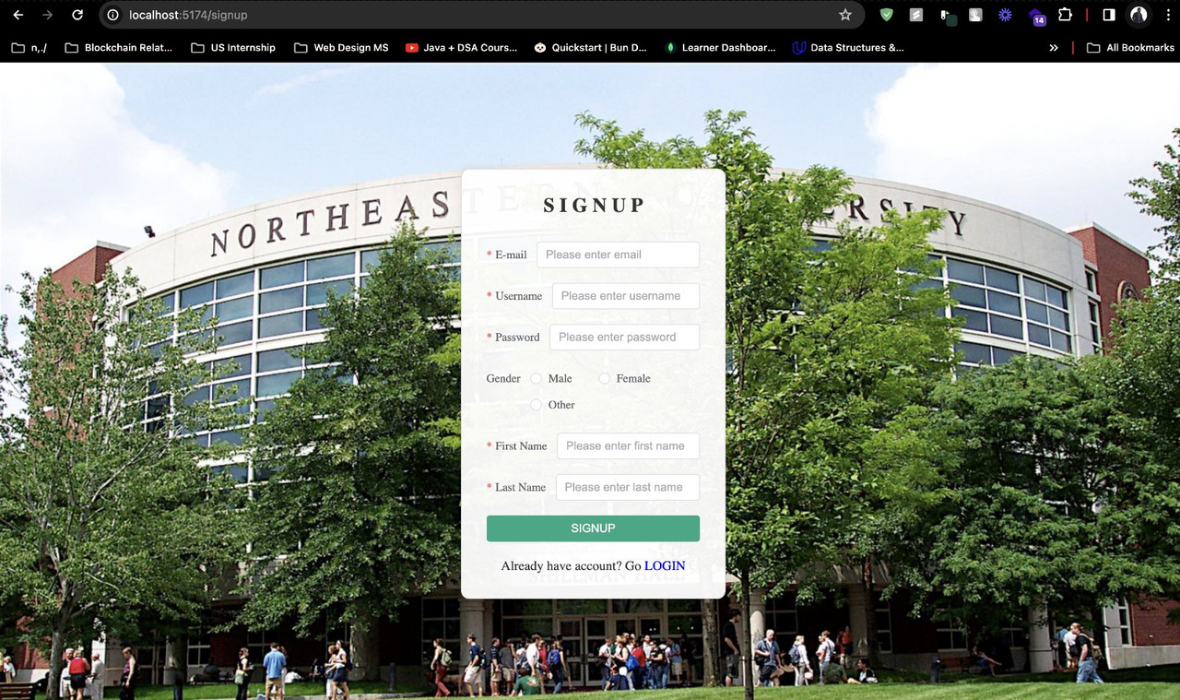
USER-CENTRIC DESIGN

Slide 5
CONTRIBUTIONS
BASAVARAJ PATIL
WORKED ON CONTROLLER AND SERVICES CLASSES
BHUVAN RAJ
WORKED ON BACKEND CREATED MAPPER AND SERVICE CLASSES. CREATED LOGIN AND SIGNUP PAGE
SAURAV SINGH
WORKED ON BACKEND CREATED CONTROLLER AND SERVICE CLASS
RAHUL POTHIRENDI
WORKED ON DATABASE , CREATED MAPPER PACKAGES TO CREATE SUBCLASSES FOR CONNECTION
ROHIT VARMA
WORKED ON DATABASE AND UI IMPLEMENTATIONS
MALAV BHATT
WORKED ON DATABASE , CREATED MAPPER PACKAGES TO CREATE SUBCLASSES FOR CONNECTION
ERIK BOYUAN YE
WORKED ON BACKEND AND FRONTEND IMPLEMENTATIONS
REVANTH
WORKED ON DATABASE , CREATED MAPPER PACKAGES TO CREATE SUBCLASSES FOR CONNECTION

Slide 6
IMPLEMENTATION
THE APPLICATION UTILIZES A RELATIONAL DATABASE TO STORE USER PROFILES, WORKOUT DATA, AND OTHER RELEVANT INFORMATION. SPRING DATA JPA SIMPLIFIES DATABASE INTERACTIONS, ENSURING EFFICIENT DATA RETRIEVAL AND STORAGE.
FITNESS BOASTS A RESPONSIVE AND USER-FRIENDLY INTERFACE DESIGNED WITH HTML AND CSS. THE FRONTEND IS OPTIMIZED FOR VARIOUS SCREEN SIZES AND DEVICES, PROVIDING A CONSISTENT EXPERIENCE ACROSS DESKTOPS, TABLETS, AND SMARTPHONES.

Slide 7
IMPLEMENTATION

Slide 8

CONCLUSION
Fitness App stands as a testament to the seamless integration of Java Spring Boot for a robust backend and HTML, CSS, and JavaScript for an engaging frontend. The application not only tracks fitness but also provides a personalized and interactive experience, making it a go-to choice for individuals committed to their health and wellness journey.

